Slide 1
Non Linear Data Structures

Slide 2


Slide 3
Defination of Tree
Trees are non-linear data structures.
Used to represent a hierarchical relationship
between the elements.

Slide 4
TERMINOLOGY- To Define Relationship b/w nodes of a Tree
NODE:A node is the key component of the tree data structure that stores the data element and may contain zero, one or more link to other successor node for connectivity. A tree consist of finite set of nodes.
EDGE or LINK: A directed line from one node to the other successor node is called edge of the tree .
It is also known as link or arc or branch of a tree.
A tree consists of a finite set of edges that connects node.

Slide 5
PARENT: The immediate predecessor of a node is called its parent.All the nodes except the root node have exactly one parent.
CHILD: All the immediate successors of a node are known as its child. If a node has two child then one on the left is called left child and other on the right is called right child.
SIBLING: Two or more nodes with same parents are called siblings.
ROOT: The topmost node of the tree is called the root of the tree.One can reach any node of the tree from the root node by following the edges.

Slide 6
LEAF: The node that does not have any child node is called leaf node.
LEVEL: The level of the node is an integer value that measures the distance of a node from the root. As the root is at zero distance from itself so it is at level 0.
DEGREE: The maximum number of children that are possible for a node is known as degree ,like in binary tree max 2 children can be there so degree is 2 .The node with degree 0 is a terminal
node. Degree is also number of subtrees.

Slide 7
HEIGHT: The height of a tree is the length (number of edges) of the path from the node to its furthest leaf .
Similar: If two trees have same shape.
Copy: If two trees have same shape and content.

Slide 8
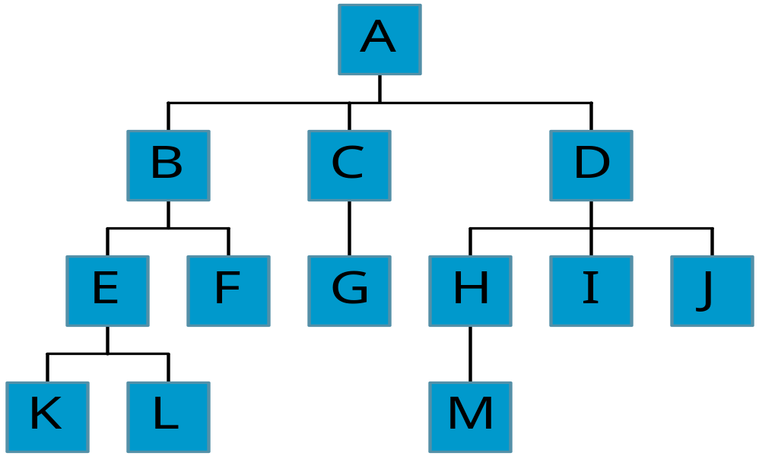
Level and Depth
node (13)
degree of a node(shown by green number)
leaf (terminal)
nonterminal
parent
children
sibling
ancestor
descendant
level of a node
height(depth) of a tree (3)
Level
0
1
2
3
3
2
1
3
2
0
0
1
0
0
0
0
0

Slide 9
Tree Properties
Property Value
Number of nodes
Height
Root Node
Leaves
Interior nodes
Number of levels
Ancestors of H
Descendants of B
Siblings of E
degree of node A
A
B
C
D
E
F
G
H
I

Slide 10

Binary trees: introduction (complete and extended binary trees),
Memory representation (sequential, linked)
Binary tree traversal: pre-order, in-order and post-order (traversal algorithms using stacks)

Slide 11


Binary Trees
A special class of trees: max degree (Atmost) for each node is 2
A binary tree T is defined as a finite set of nodes such that
    T is empty or null tree
    T consists of a root and remaining nodes from an ordered pair of two disjoint binary trees called the left subtree and the right subtree.

Slide 12

A
B
E
C
G
D
K
F
H
L
M
I
J

Slide 13
Samples of Trees
A
A
Complete Binary Tree
A
B
B
Skewed Binary Tree
C
B
C
D
D
E
F
G
E
H
I

Slide 14
Maximum Number of Nodes in BT
The maximum number of nodes on level i of a binary tree is 2^{i}, i>=0.
The maximum number of nodes in a binary tree of depth k
is 2^{k}-1, k>=1. when level starts with 1
And 2(^{k+1)}-1 when level starts with 0

Slide 15
Full BT vs. Complete BT
A full binary tree of depth k is a binary tree of depth k having 2^{k}-1 nodes, k>=1.
A binary tree with n nodes and depth k is
complete iff its nodes correspond to the nodes numbered from 1 to n in the full binary tree of depth k.
A
A
B
C
B
C
D
E
F
G
D
E
F
G
H
H
I
J
K
L
M
N
O
I
Complete binary tree
Full binary tree of depth 4

Slide 16
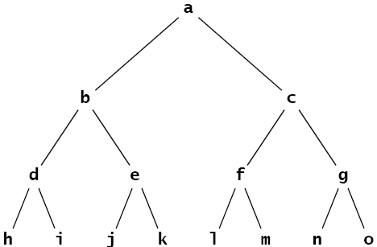
Full Binary Tree
A binary tree is said to be full binary tree if each node has exactly zero or two children.
Also known as proper binary tree

Slide 17
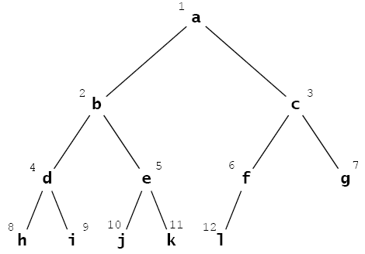
Complete Binary Tree
A complete binary tree is either a full binary tree or one in which every level is fully occupied except possibly for the bottomost level where all the nodes must be as far left as possible.

Slide 18
[1]
[2]
[3]
[4]
[5]
[6]
[7]
[8]
[9]
A
B
C
D
E
F
G
H
I
Sequential Representation
[1]
[2]
[3]
[4]
[5]
[6]
[7]
[8]
[9]
.
[16]
A
B
--C
--
--
--
D
--
.
E
(1) waste space
(2) insertion/deletion
problem
A
B
A
C
B
C
D
D
E
F
G
E
H
I

Slide 19

Linked Representation
INFO LEFT RIGHT ROOT
AVAIL
2
A
E
C
B
D
F
0
6
0
0
8
7
0
1
0
5
4
0
9
3
0
0
10

Slide 20
Linked Representation
struct btnode {
int data;
btnode *left, *right;
};
data
left
data
right
left
right

Slide 21
Binary Tree Traversal

Slide 22

Binary Tree Traversals
There are three standard ways of traversing a binary tree T with root R.
These three algorithms, called:
  preorder
  inorder
  postorder

Slide 23
Tree Traversals
Pre-Order
  N L R
In-Order
  L N R
Post-Order
  L R N

Slide 24
Preorder Traversal of Binary Tree
PREORDER (INFO, LEFT, RIGHT, ROOT )
IF: ROOT == NULL
THEN: Return
Print ROOT -> INFO
Call PREORDER(ROOT -> LEFT)
Call PREORDER(ROOT -> RIGHT)
Notes:
목차
자바의 생성배경
자바를 사용하는 이유
과거, 현재, 미래의 자바
자바의 발전과정
버전별 JDK에 대한 설명
자바와 C++의 차이점
자바의 성능
자바 관련 산업(?)의 경향

Slide 25
Inorder Traversal of Binary Tree
INORDER (INFO, LEFT, RIGHT, ROOT )
IF: ROOT == NULL
THEN: Return
Call INORDER(ROOT -> LEFT)
Print ROOT -> INFO
Call INORDER(ROOT -> RIGHT)
Notes:
목차
자바의 생성배경
자바를 사용하는 이유
과거, 현재, 미래의 자바
자바의 발전과정
버전별 JDK에 대한 설명
자바와 C++의 차이점
자바의 성능
자바 관련 산업(?)의 경향

Slide 26
Postorder Traversal of Binary Tree
POSTORDER (INFO, LEFT, RIGHT, ROOT )
IF: ROOT == NULL
THEN: Return
Call POSTORDER(ROOT -> LEFT)
Call POSTORDER(ROOT -> RIGHT)
Print ROOT -> INFO
Notes:
목차
자바의 생성배경
자바를 사용하는 이유
과거, 현재, 미래의 자바
자바의 발전과정
버전별 JDK에 대한 설명
자바와 C++의 차이점
자바의 성능
자바 관련 산업(?)의 경향

Slide 27
Review Questions
Given Inorder and Preorder Traversal of a binary tree:
Preorder: L, G, D, C, M, H, T, K
Inorder: G, D, L, C, H, T, M, K
Construct the binary tree and find out the Postorder traversal of the Tree.
Notes:
목차
자바의 생성배경
자바를 사용하는 이유
과거, 현재, 미래의 자바
자바의 발전과정
버전별 JDK에 대한 설명
자바와 C++의 차이점
자바의 성능
자바 관련 산업(?)의 경향

Slide 28
Review Questions
Given Inorder and Post order Traversal of a binary tree:
Postorder: E, F, L, G, D, N, P
Inorder: G, E, L, F, P, D, N
Construct the binary tree and find out the Preorder traversal of the Tree.
Notes:
목차
자바의 생성배경
자바를 사용하는 이유
과거, 현재, 미래의 자바
자바의 발전과정
버전별 JDK에 대한 설명
자바와 C++의 차이점
자바의 성능
자바 관련 산업(?)의 경향

Slide 29


